Slide 1



Occupations and Health
Employee Health
A Data analysis of Lifestyle effects on Individual Health of people in Different occupations
By Nicholas Seremba
2023-M132-21498
August 2024

Slide 2
About the dataset
01
Volume
04
Veracity
The dataset represents Multiple entries across various health and lifestyle parameters .
The dataset includes accurate and sensitive health data, which needs which was reliably recorded for analyses from a credible survey.
02
Velocity
5 Vs of Big Data
Dataset was collected in a single survey from all employees in the different occupations and is not being updated
Value
05
The dataset’s value is in its ability to reveal how lifestyle choices impact health, providing key insights for improving well-being.
03
Variety
The dataset contains a diverse range of data types, including qualitative, quantitative, and binary information, which together provide a detailed overview of individual health profiles.

Slide 3
Cont.. About the dataset
01
Volume
04
Veracity
The dataset represents Multiple entries across various health and lifestyle parameters.
The dataset includes accurate and sensitive health data, which needs which was reliably recorded for analyses from a credible survey.
02
Velocity
5 Vs of Big Data
Dataset was collected in a 1 off survey from all employees in the different occupations and is not being updated
Value
05
The dataset’s value is in its ability to reveal how lifestyle choices impact health, providing key insights for improving well-being.
03
Variety
The dataset contains a diverse range of data types, including qualitative, quantitative, and binary information, which together provide a detailed overview of individual health profiles.

Slide 4
Occupations Data Demographics
71
63
73
19%
16.7%
47
37
12.5%
1
19.4%
9.8%
Doctors
Engineers
0.3%
Lawyers
Managers
Nurses
Accountants
4
4o
32
1.1%
10.4%
2
8.4%
4
Software
Engineers
0.4%
1.1%
Sales
Representative
Sales Persons
Scientists
Teachers
347 Employees
Different Occupations
Different Lifestyles

Slide 5
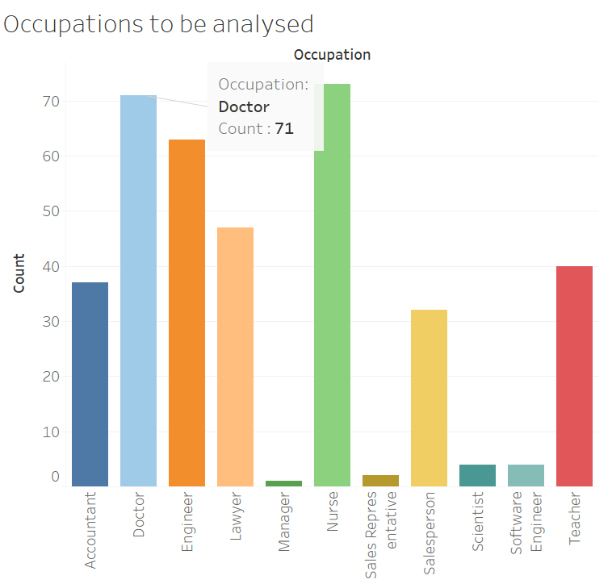
Occupations Data Demographics
Doctors and Nurses
Different occupations are represented.
Doctors and nurses having the largest representation
Outliers
All Occupations with a count below 5%
have been deemed as outliers in this analysis

Slide 6
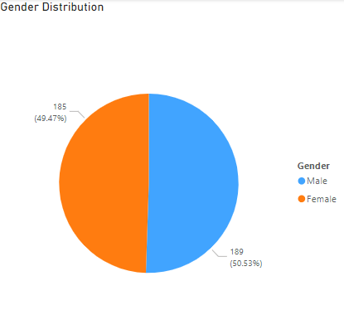

Occupations Data Demographics
Gender Distribution
Females
Females in this dataset make up 49.5% of the population in the dataset
Males
Males make up 50.5% of the population in the dataset
Quick Insight:
The dataset is fairly distributed by gender.
This will be used to understand lifestyle implications based on gender in the same occupation types.

Slide 7
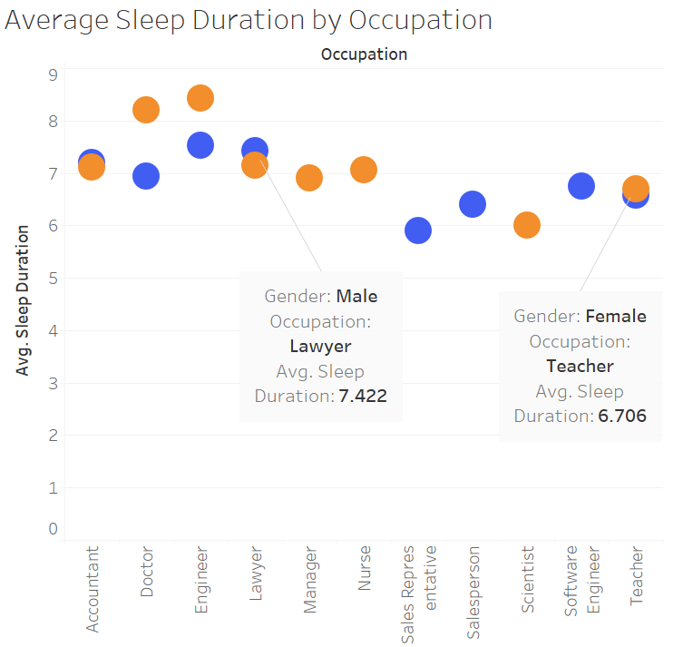

Lifestyle Analysis
Sleep Patterns
General Overview
Most Employees in all occupations sleep between 6 to 9 hours.
Men sleep less hours than women. Some occupations only had 1 gender represented.
Females
Female employees have more rest
There is a noted Sleep duration for an average of 7.2 hours
Males
male employees Generally sleep for less hours.
There is a noted Sleep duration for an average of 7 hours
Quick Insight:
A question. Why do male doctors and engineers sleep for less hours?
Could it be a workload imbalance or something not related to work?

Slide 8
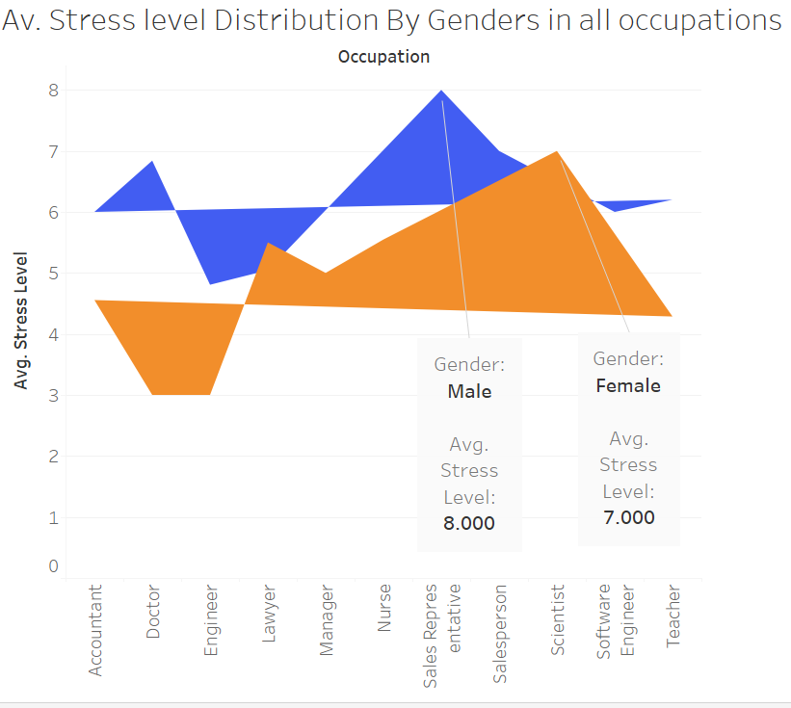
Lifestyle Analysis
The Stress factor
General Overview
The Men in the overall occupations are more stressed than women
Females
Female employees have an average stress level of 4.6
Males
Male employees have an average stress level of 6.1
Quick Insight:
Men are So Stressed. However some women are more stressed than some men.
A question. Could there be a relationship between sleep durations and stress levels?

Slide 9
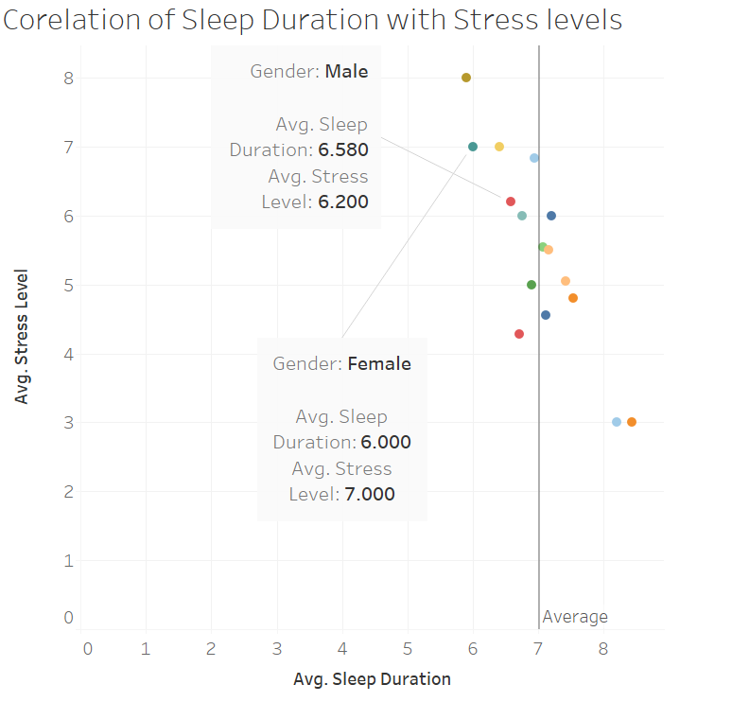
Lifestyle Analysis
The Stress Correlation to Sleep Duration
General Overview
Both Men and Women who sleep less than 7 hours present high Stress levels.
Females
Most women sleep more than 7 Hours. The Female Scientist who sleeps less than 7 hours presented high stress levels.
Males
Men who sleep for more than 7 hours present low stress levels.
Insight:
Less Sleep increases stress levels in both men and Women.

Slide 10
Lifestyle Analysis
The Stress Correlation to Sleep Duration
General Overview
Both Men and Women who sleep less than 7 hours present high Stress levels.
Females
Most women sleep more than 7 Hours. The Female Scientist who sleeps less than 7 hours presented high stress levels.
Males
Men who sleep for more than 7 hours present low stress levels.
Insight:
Less Sleep increases stress levels in both men and Women.

Slide 11
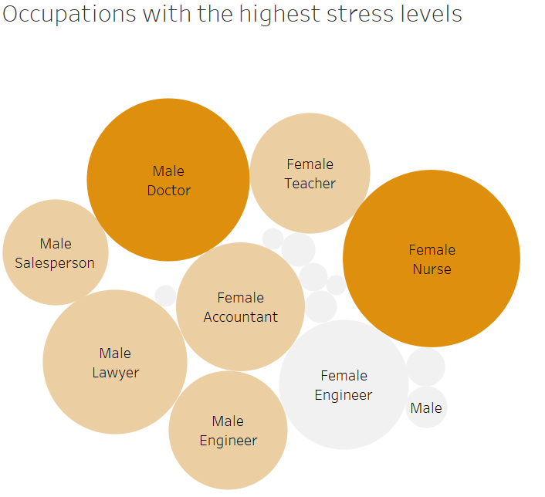
Lifestyle Analysis
General Stress level overview in Different Occupations
General Overview
Both Men and Women who sleep less than 7 hours present high Stress levels.
Females
Most women sleep more than 7 Hours. The Female Scientist who sleeps less than 7 hours presented high stress levels.
Males
Men who sleep for more than 7 hours present low stress levels.
Insight:
The Darker the Color, reflects more stress

Slide 12
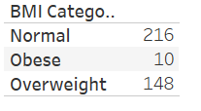
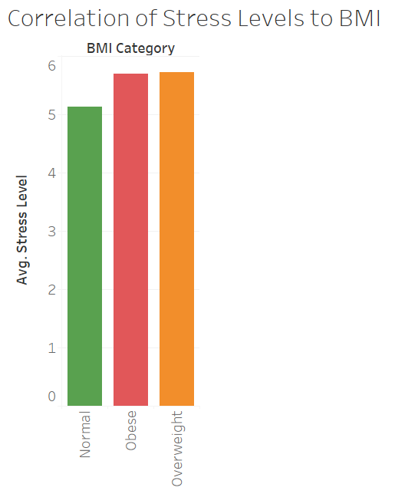
Health Analysis
The Stress Correlation to Body Mass Index(BMI)
General Overview
More than 50 % of the employee have a normal BMI count.
The obese and overweight people also presented high stress levels compared to normal people
Insight:
High stress levels in employees could cause obesity and overweight. This can be further correlated with new data to better understand the causal Relationships between the two variables.

Slide 13



THE BIG WORDS
More than 7 Hours Sleep Duration
Reduces Stress levels on the job
ENOUGH SLEEP
AND
REGULAR EXERCISE
BODY MASS INDEX
Stress Levels
An increase in BMI could lead to future health complications
Could lead to increased Body Mass Index(BMI)

Slide 14
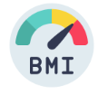

The INSIGHT
QUALITY SLEEP
STRESS LEVELS
BMI CATEGORY
GOOD HEALTH
Have Quality sleep
To Reduce Stress levels
In order to keep the Body Mass index in check
Which will guarantee good health and performance at work place.

Slide 15
A Percentage-Based Analysis of the 5 Vs of Big Data in Health Metrics
25%
Volume
The dataset is moderately large, reflecting a significant amount of data in the different occupations
25%
Variety
There is a good mix of data types, indicating a diverse range of information
Veracity
35%
The accuracy , reliability and sensitivity of the health data
15%
Value
The insights have been gained from analyzing the dataset are valuable for health outcomes.

Slide 16
Challenges
Given that the data was collected by another party, it’s quality and completeness to fully answer questions beyond its scope was a challenge
Data Quality
Data from different sources was challenging to integrate in the cases where it had different formats, and variables.
Data Integration
In the case of personal data, itethical dilemmas in useof health data from a survey not taken by me was a challenge
Data Privacy:
Data Challenges
Data Processing
Using different tools to mine insights from the data during processing was tasking
Data Interpretation
Extracting value from the data by identifying meaningful patterns and insights is a complex task.

Slide 17
THANK YOU

